Slide 1
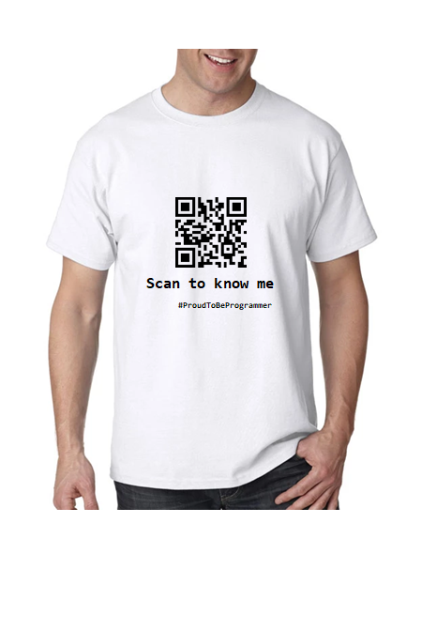
USAPANG TSHIRT
Ano po ang mga sizes?
How to order po?
Payment methods?

Slide 2
SIZE and PRICE
SIZE | PRICE
S | 350
M | 350
L | 350
XL | 370
XXL | 370
XXXL | 380

Slide 3
PAYMENT METHOD
BDO Account Number: xxxxx-xxxx-xxxxx RICKY BOY D. SANGALANG
GCASH NUMBER: 0918-754-2121 RICKY BOY D. SANGALANG

